Slide 1
Basics of Machine Learning with Python
A 2 day hands on workshop by Evam Kaushik

Slide 2
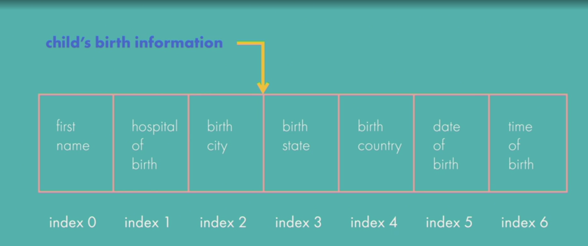
Tuples
When working with collections of data, you might encounter a situation where you want to store some information in a sequence and ensure that the sequence is not changed afterwards. Say you're given a task involving a set of children's birth information. For each child, you have their first name, the hospital where they were born, their birth city, their birth state, their birth country, their date of birth and their time of birth. You want to store the birth information of each child in a sequence. You do not want that sequence to be tampered with or altered, so you need to use a sequence that cannot be changed after creation. Don't worry, Python has a type of sequence that helps you do this easily and it's called a tuple. A tuple has a specific order and the items in a tuple cannot be changed once created. Parentheses are used to enclose the items in the tuple and commas are used to separate the items from each other.

